Slide 1

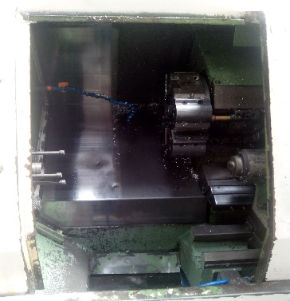
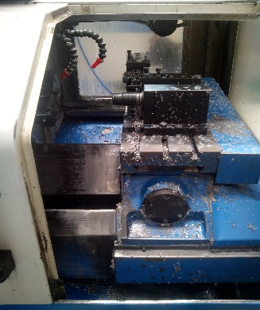
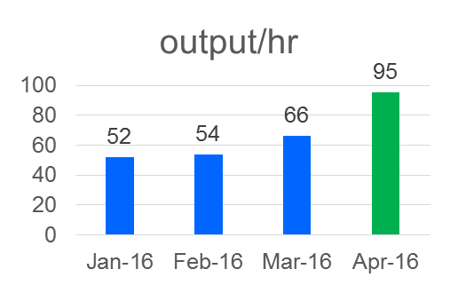
P15
TPM CIRCLE NO :- 01
ACTIVITY
KK
QM
PM
JH
SHE
OT
DM
E&T
KAIZEN IDEA SHEET
TPM CIRCLE NAME: Achiever
LOSS NO. / STEP
DEPT :- MACHINE SHOP
RESULT AREA
P
Q
A
C
D
S
M
CELL:- A360 CKD
CELL NAME:- TENSIONER
MACHINE / STAGE :- Machining
OPERATION :- Tensioner
KAIZEN THEME – To reduce cut time and tool change time
IDEA :- Replace lmw machine with colt machine from oil pump
Problem present status- Cycle time is 30 sec against 21 sec
COUNTERMEASURE:-
1. Turret indexing machine to be replace with non turret indexing machine
BENCHMARK
66/hr
TARGET
120/hr
KAIZEN START
13.04.2016
TDC
20.04.2016
KAIZEN FINISH
TEAM MEMBERS :
1.santosh,amol,Walunj,sachin chaudhari,
pawar sir
BENEFITS :-
PRODUCTION OUTPUT INCREASE BY 61 NOS/hr
Output /Hr Incresed by 43%
Before
After
KAIZEN SUSTENANCE
WHY - WHY ANALYSIS :-
Why1 :- cycle time is 30sec
why2:- cut time is more
Why3 :- tool change time is more
Why4 :- tool change during Turret indexing,
RESULT :- Production output/Hr increased from
average 66 to 95 and reach up to 127/hr
WHAT TO DO.process audit
HOW TO DO:-. Std vs actual process parameter
FREQUENCY :-1/month
ROOT CAUSE :- Turret Indexing not required
REGISTRATION NO. & DATE : 12.04.2016
SCOPE & PLAN FOR HORIZONTAL DEPLOYMENT
REGISTERED BY :-Dyp.
SR.
NO.
CELL
TARGET
RESPONSIBILITY
STATUS
MANAGER’S SIGN :- Santosh wakchaure
1
Tensioner

